Slide 1
[0,97,115,109,1,0,0,0,1,133,128,128,128,0,1,96,0,1,127,3,130,128,128,128,0,1,0,4,132,128,128,128,0,1,112,0,0,5,131,128,128,128,0,1,0,1,6,129,128,128,128,0,0,7,146,128,128,128,0,2,6,109,101,109,111,114,121,2,0,5,104,101,108,108,111,0,0,10,138,128,128,128,0,1,132,128,128,128,0,0,65,16,11,11,146,128,128,128,0,1,0,65,16,11,12,72,101,108,108,111,32,87,111,114,108,100,0]

Slide 2
Welcome To York Code Dojo
David Betteridge @da_betteridge
Yorkdevelopers.org
@yorkdevelopers
@yorkcodedojo
Notes:
Who has used web assembly?
Who has heard of it?
Who is a frontend web dev?
Who hasn’t every written any Javascript
Thank you to York St Johns for food and room

Slide 3
Agenda
Quick Introduction
Explain the problem
Work in pairs till 8.45pm
Opportunity to show off solutions
Pub about 9pm

Slide 4

Code Dojo
Notes:
Aim for tonight isn’t to get a job, but to learn something news.
Who has been to a code dojo before?
What is the point?
It’s a place to practice coding safely. By that we mean it doesn’t matter if you haven’t solved the problem by the end of the evening. No one will judge you on it. It’s a place to practice, learn and try out new things.
For example you could use a language you have never used before, partner with someone new, try a different approach to solving the problem. You could add your own constraints; like my functions won’t have more than three lines; or I’m not going to use any IF statements.
(It’s also meant to be fun) It’s driving a car to work every day, you might cover a lot of miles, but if you are doing the same journey then does your driving ability really improve?
It’s driving a car to work every day, you might cover a lot of miles, but if you are doing the same journey then does your driving ability really improve?

Slide 5
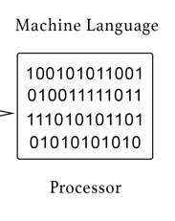
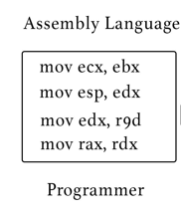
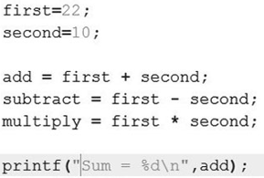
Notes:
Simplified!
Computers understand instructions which are stored as 0 and 1s in memory
Because 1001001110 is hard to remember which give them nice names such as mov or add
Because assembly is very low level, no constructs such as for loops, we then use languages such as C
But that was in the past - what about modern day stuff?

Slide 6
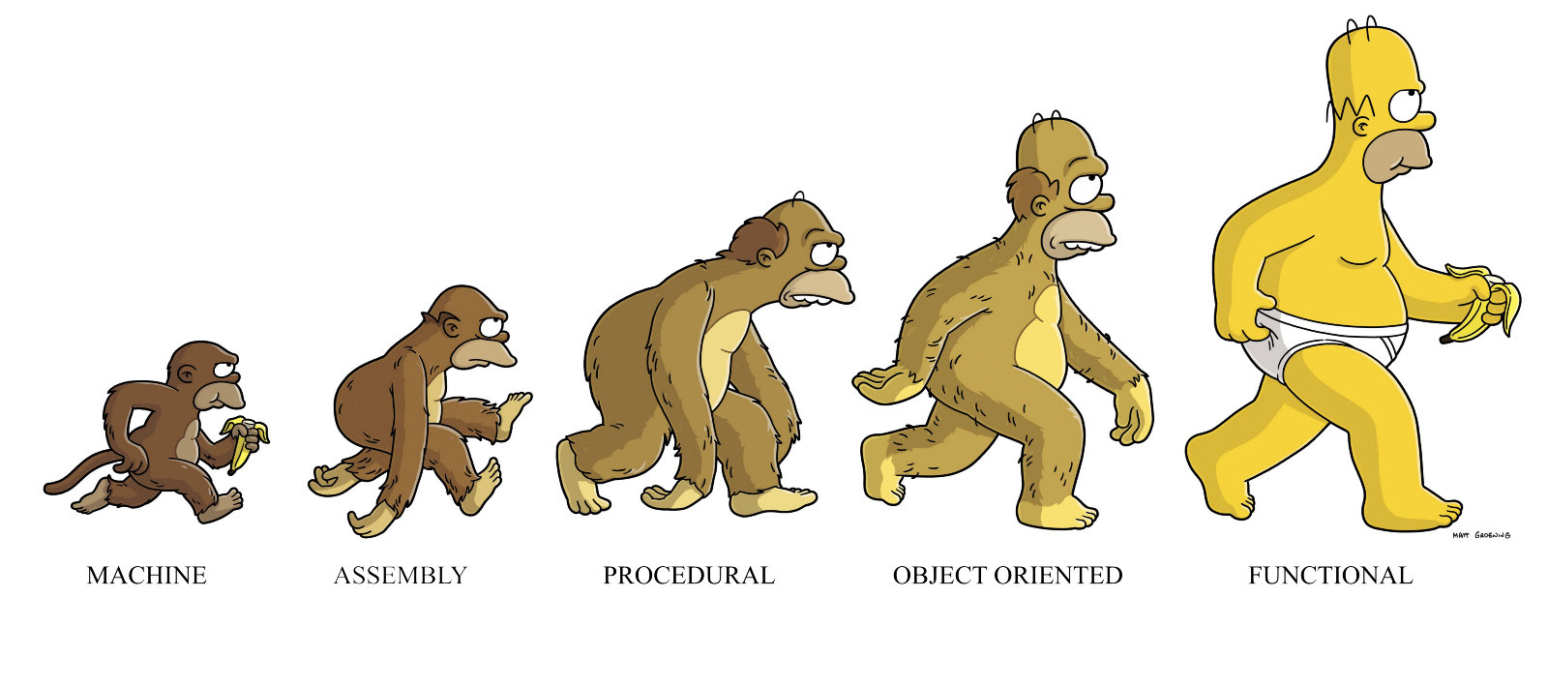
Notes:
A few blogs have been using this imaging when promoting functional languages
I don’t think this is really true

Slide 7
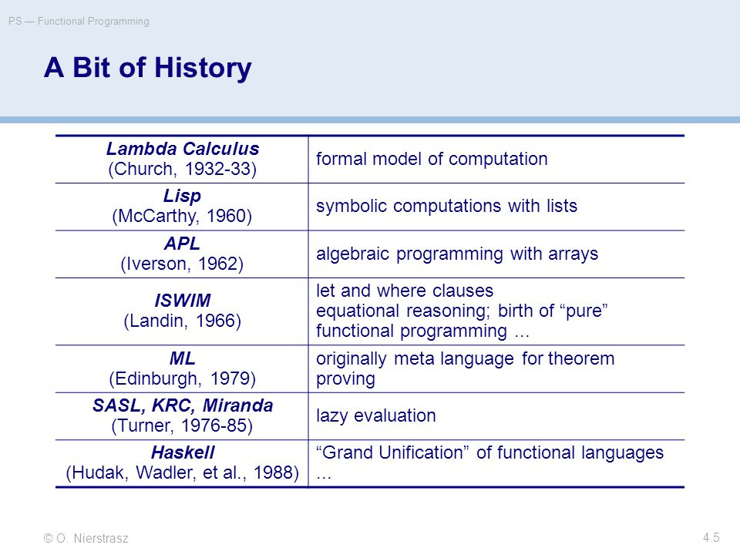
Notes:
Note, C, C++ etc aren’t mentioned
Lambda calculus was invented in 1932
What’s the difference – the former are based on the hardware of the machine, whilst functional languages are based on Maths.
But where does Javascript fit in?
- Languages (C#, Kotlin, Javascript) now fall in the middle.

Slide 8
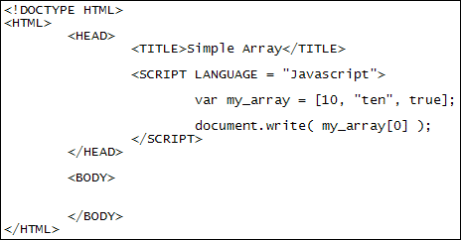
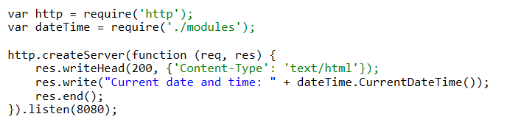
Javascript
Notes:
10 days in May 1995 by Brendan Eich
It’s embedded in web pages
There are lots of frameworks – from jquery to angular 8
It can be used on the server

Slide 9
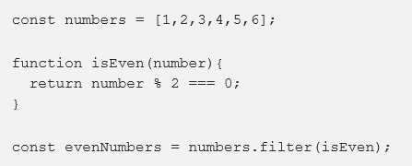
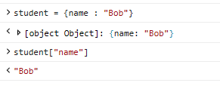
Notes:
And it can be functional
And dynamic

Slide 10
!![] + !![]
function dojo(name, session, date) { return name; }
dojo("David")
a = "David“
b = 43
c = a + b
d = b + b
Notes:
But also strange….

Slide 11

Notes:
Languages like TypeScript exist which can transpile into Javascript

Slide 12
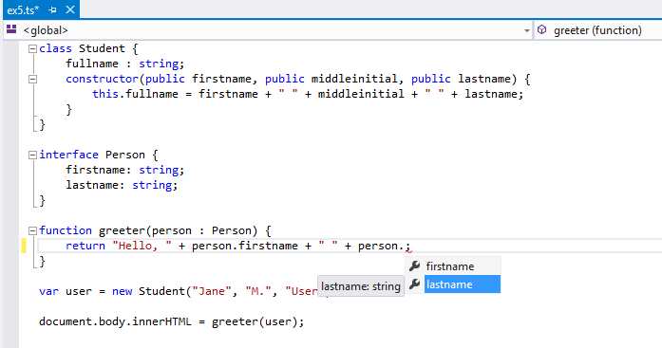
Notes:
This gives us some type safety, IDE assistance. (Although recent versions of Javascript also support some of this, they don’t stop you from shooting yourself in the foot)

Slide 13
TypeScript
Javascript
Minified
Notes:
Javascript is the assembly language of the web

Slide 14
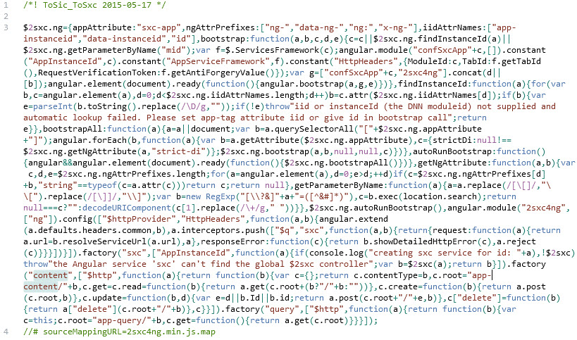
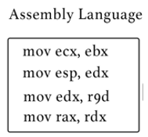
Notes:
– maybe not

Slide 15
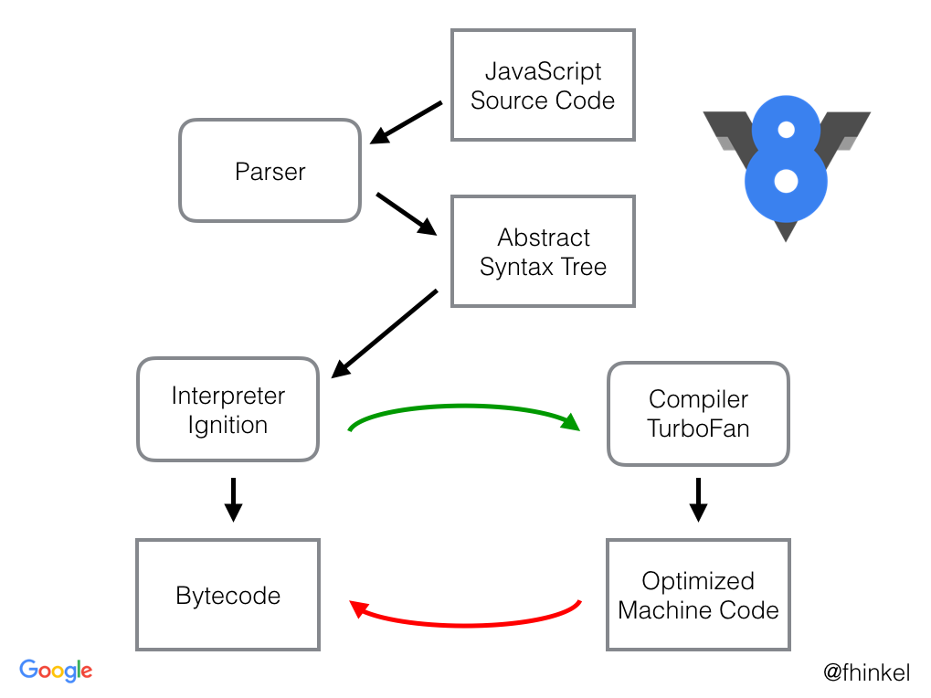
Notes:
What happens with the Javascript when your browser sees it?
Explain
The top bit is quite slow
The bottom bit is quite clever
What we really want, is the ability to program in a nice language and some how miss out the slow part…

Slide 16
“WebAssembly (abbreviated Wasm) is a binary instruction format for a stack-based virtual machine. Wasm is designed as a portable target for compilation of high-level languages like C/C++/Rust, enabling deployment on the web for client and server applications.”
https://webassembly.org/
Notes:
In other words, you write the code in a language of your choice and it compiles down to WebAssembly
WebAssembly is an intermediate format more akin to .NET or Java bytecode than machine code.

Slide 17

Notes:
It’s supported in the 4 major browsers

Slide 18
https://mbebenita.github.io/WasmExplorer/
int squarer(int num) {
return num * num;
}
Notes:
Use chrome
Note generated function name
Explain Javascript shim – will be built in
F12 -> Console -> squarer(11)

Slide 19
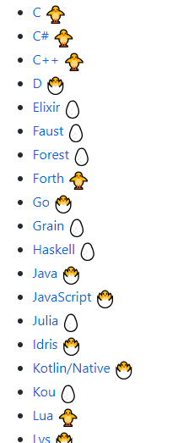
https://github.com/appcypher/awesome-wasm-langs
Notes:
What if you don’t like C
Supported Languages

Slide 20



Single-page applications (SPA)
“A single-page application (SPA) is a web application or web site that interacts with the user by dynamically rewriting the current page rather than loading entire new pages from a server. ”
Notes:
Gmail etc
But they have a lot of javascript

Slide 21

Notes:
Blazor is the C# version
Demo Pages
Community - https://blazor.net/community.html
Custom Components

Slide 22
Tonight
WASM
BLAZOR
?
Notes:
Either….
https://mbebenita.github.io/WasmExplorer/
Try creating your own wasm file, either using the an online tool or download one for a language of your choice. Ideas to get you started.
Write a program to add two numbers together
Write a program which returns a string
Compare the performance of a native javascript program with a web assembly one
Can you read/update the DOM from instead web assembly.
Or
Install Blazor - https://blazor.net/
Try installing a community component
Write your own component
Write an app which calls an API from this site - https://github.com/toddmotto/public-apis

Slide 23
Resources
WIFI – YSJ Guest

Slide 24
York Developers include…
Games Developers (3rd Thursday of the month)
Code and Coffee (Monday and Wednesday mornings)
Agile York (3rd Wednesday of the month)
Dot Net York (1st Tuesday of the month)
And more

